Slide 1
Bibek Dhungel
Anirudh
Dixa
Harshith
Paderborn | 7.04.2021

Slide 2
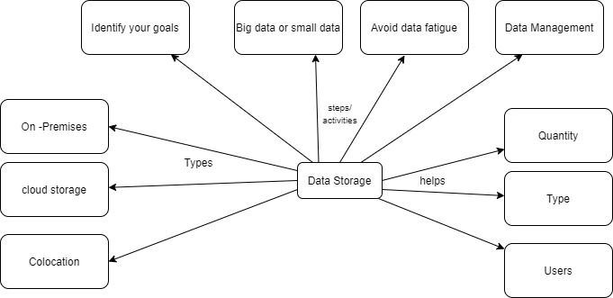
Data Storage
What is Data Storage?
Data storing in data science refers to storing of useful data which you may use in your data science process to dig the actionable
insights out of it.

Slide 3

Data Storage
Why Storage is Important?
Due to its absolute volume, how and where to store this ever-growing pool of data has become more important than ever. The IT infrastructure must be able to scale with growth and continue to provide consistent levels of performance.
Storing data is not just about how and where, but also the speed in which it can be accessed, manipulated, and presented. For example, accessing data in 5-10 ms is just too slow for a data-driven business that is responding in real time to global business opportunities on a 24×7 basis.
Factors for picking data storage:
Quantity, amount of data or size.
Type, what is the data binary, character, numeric, etc.
Users, who is accessing the data.

Slide 4


Data Storage Example
Elastic search(Search Engine)
It is a powerful, out-of-the-box text search and indexing functionality. Aside from the traditional search engine tasks, text search, and exact value queries, Elastic search also offers layered aggregation capabilities.
Columnar Store: Amazon Redshift
By storing data in columns instead of the usual rows, aggregation operations can
be executed directly from the disk, greatly increasing performance. A few
years ago, Amazon rolled out its hosted service for a columnar store called Redshift.
Document Store: MongoDB
MongoDB supports rich and adaptable querying for digging into complex documents.
Often-queried fields can be sped up through indexing, and when aggregating a large chunk of data,
MongoDB offers a multi-stage pipeline.

Slide 5
Thank You..
Questions?

